Slide 1

Cloud Native Applications
Polyglot Persistence with Spring Data REST

Slide 2
Spring Data
Provides a familiar and consistent, Spring-based programming model for data access while still retaining the special traits of the underlying data store.
It makes it easy to use data access technologies, relational and non-relational databases, map-reduce frameworks, and cloud-based data services.

Slide 3
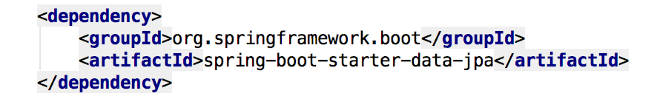
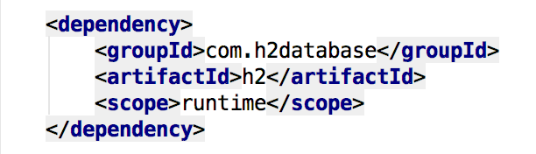

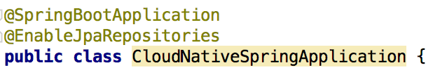
Spring Data JPA
Add the Spring Data JPA starter to our pom.xml file
Sprinkle a database connector into our pom.xml
Sprinkle a little @EnableJpaRepositories annotation into our Spring Boot application

Slide 4
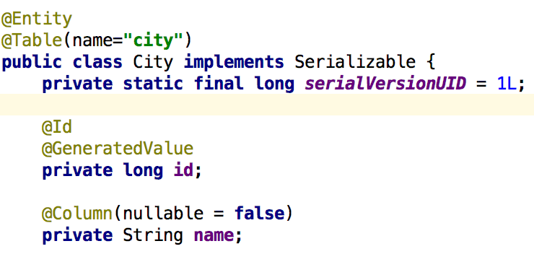
Spring Data JPA, @Entity & Repository
Let’s create an @Entity to manage
Let’s create a JPA Repository to manage our @Entity

Slide 5
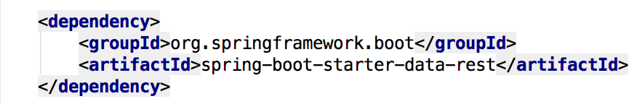
Spring Data REST
Goal is to provide a solid foundation on which to expose CRUD repositories to our repository managing entities using plain HTTP REST semantics
Add a dash of Spring Data REST starter into our pom.xml

Slide 6
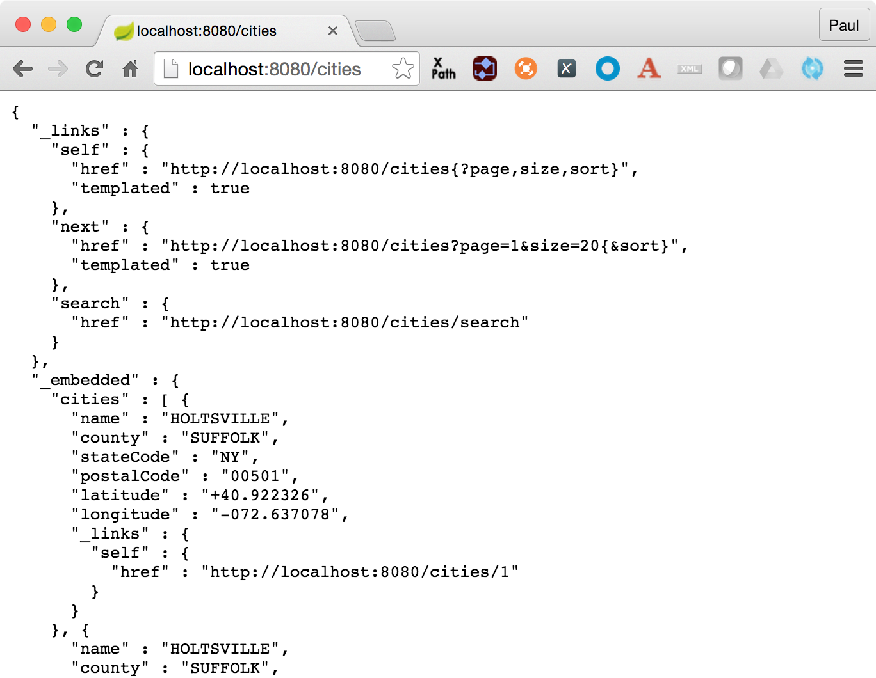
Spring Data REST, what happens
For this repository, Spring Data REST exposes a resource collection at “/cities”
Context path is derived from the un-capitalized, pluralized, simple class name of the domain class being managed
Exposes an item resource for each of these items managed by the repository under the URI template /cities/{id}

Slide 7
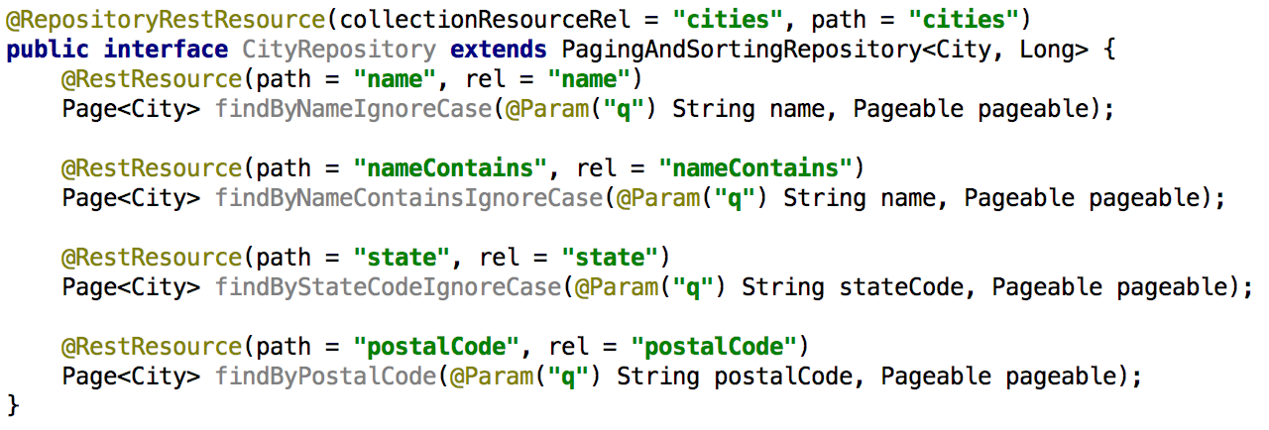
Support Search, or findBy*
Add some search methods using @RestResource to our CityRepository class

Slide 8
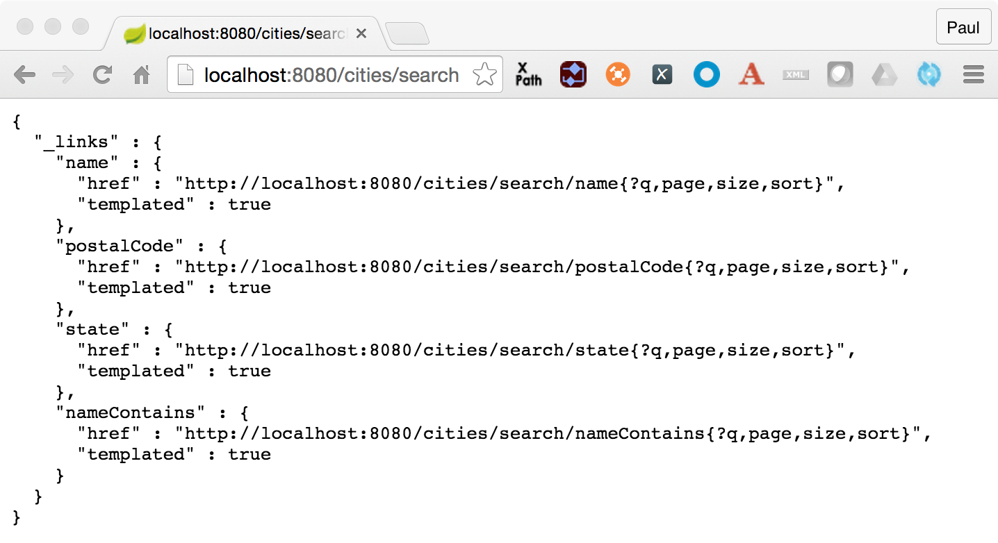
Spring Data REST, what happens?
For this repository, we now see search methods when we hit the /{repository}/search endpoint

Slide 9
Spring Data REST, Custom Queries
Add a method “findByStateCode” to our CityRepository that defines an custom query using @Query notation and takes an @Param argument for the stateCode

Slide 10
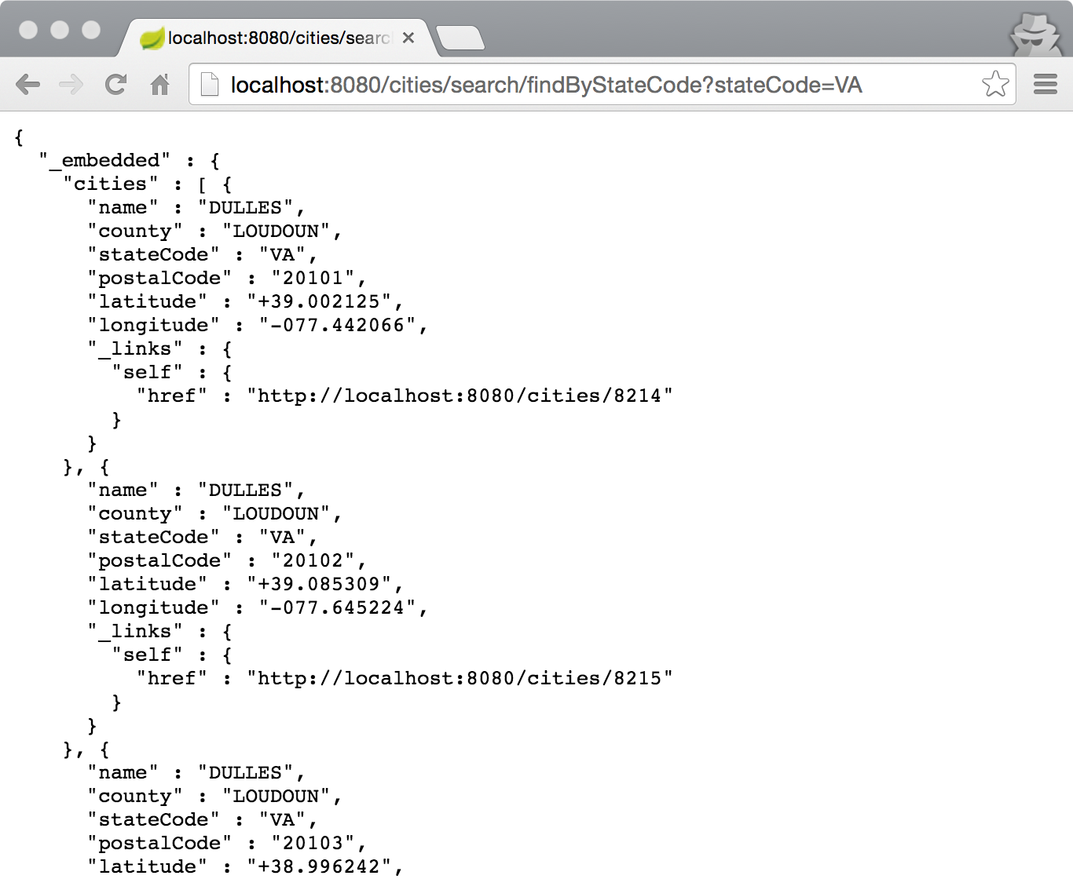
Spring Data REST, what happens?

Slide 11
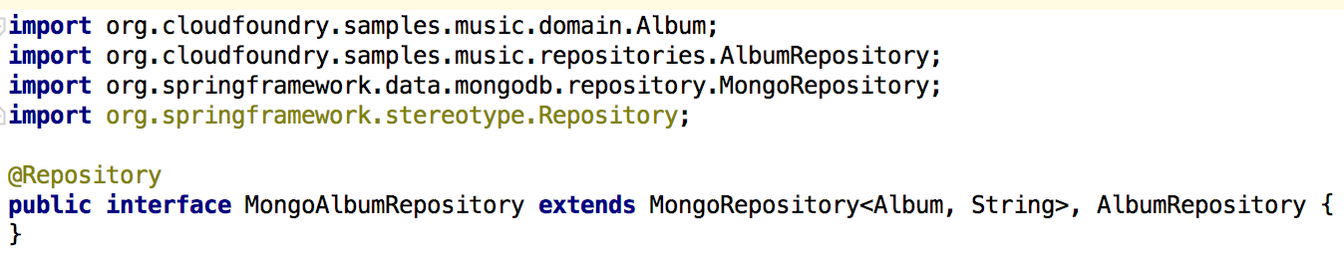
MongoRepository

Slide 12
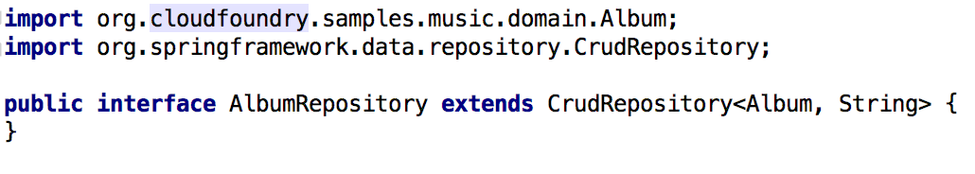
RedisRepository

Slide 13
Lab

